Slide 1




Microsoft Azure Amazon Web services

Slide 2
AWS MS Azure
AWS services are designed in such a way that they work with each other and produce a scalable and efficient outcome.
AWS offering services are categorized into 3 types such as
Infrastructure as a service (IaaS), software as a service (SaaS) and platform as a service (PaaS).
AWS was launched in 2006 and become the best cloud platform among currently available cloud platforms. Cloud platforms offer various advantages such as management overhead reduction, cost minimization, etc.
Microsoft Azure was launched in 2010 and it emerges as one of the biggest commercial cloud service providers.
It offers a wide range of integrated cloud services and functionalities such as
Analytics, computing, networking, database, storage, mobile and web applications that seamlessly integrate with your environment in order to achieve efficiency and scalability.

Slide 3
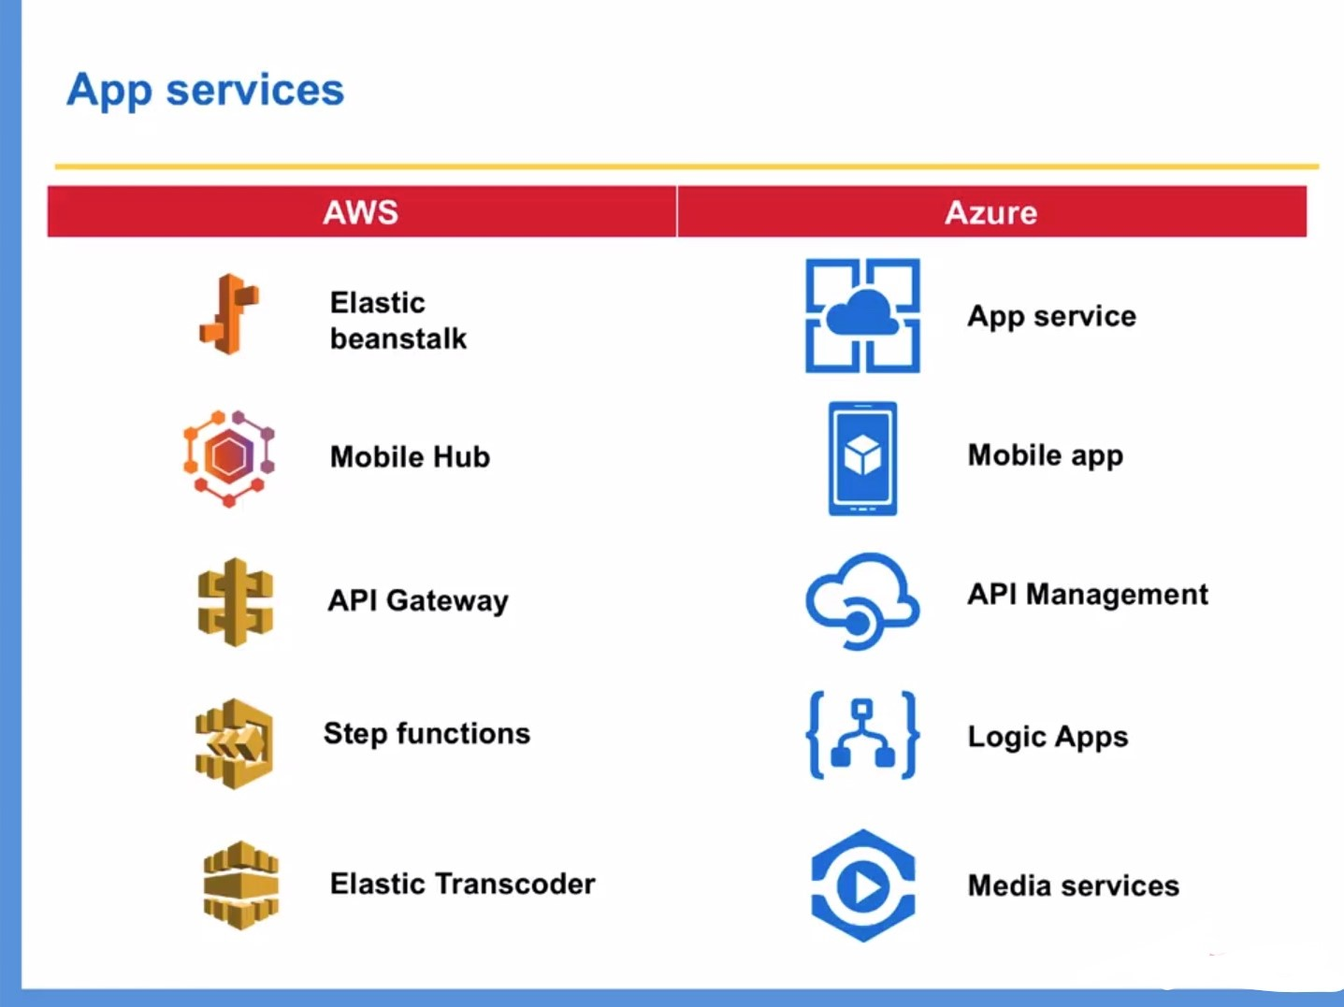

Slide 4
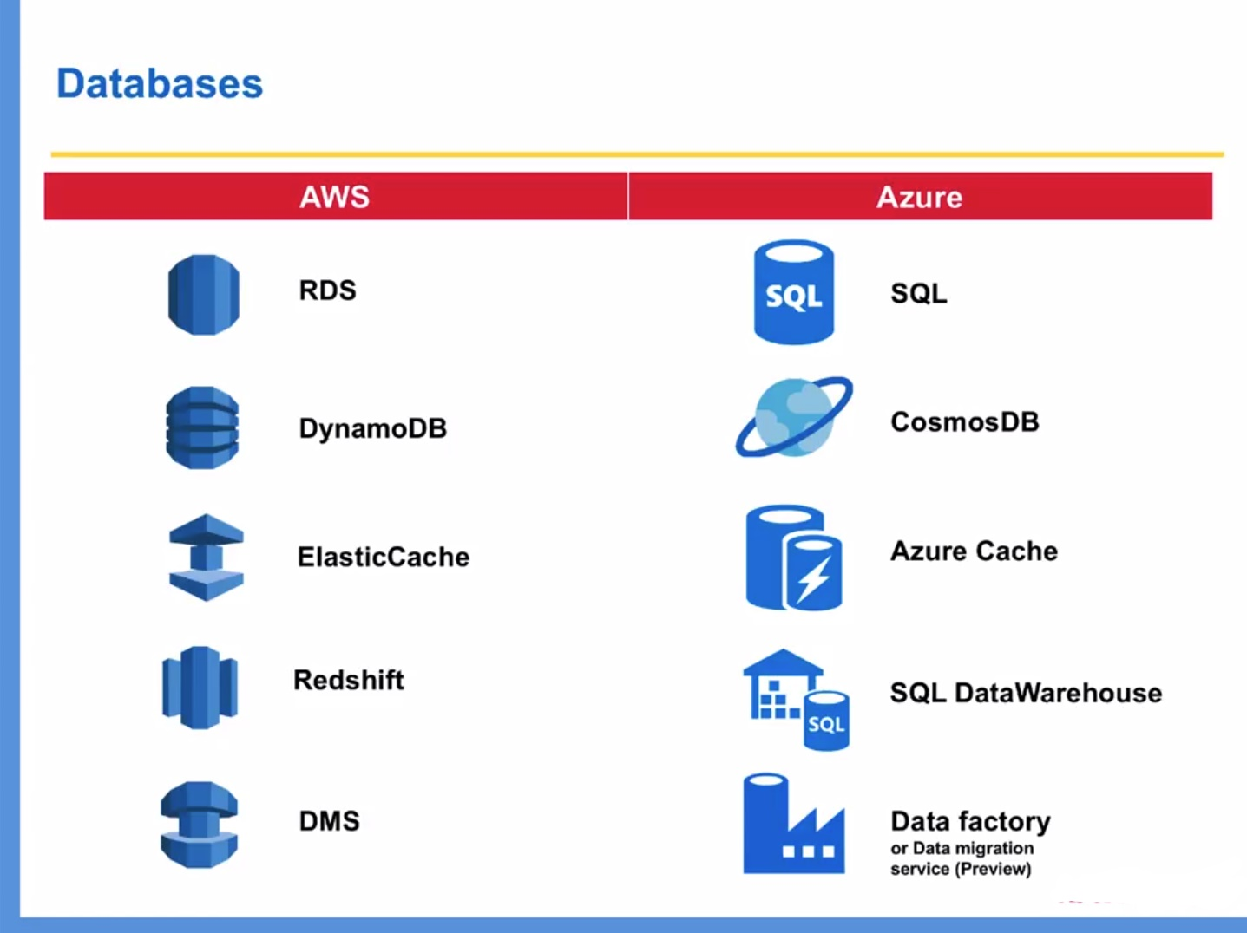

Slide 5
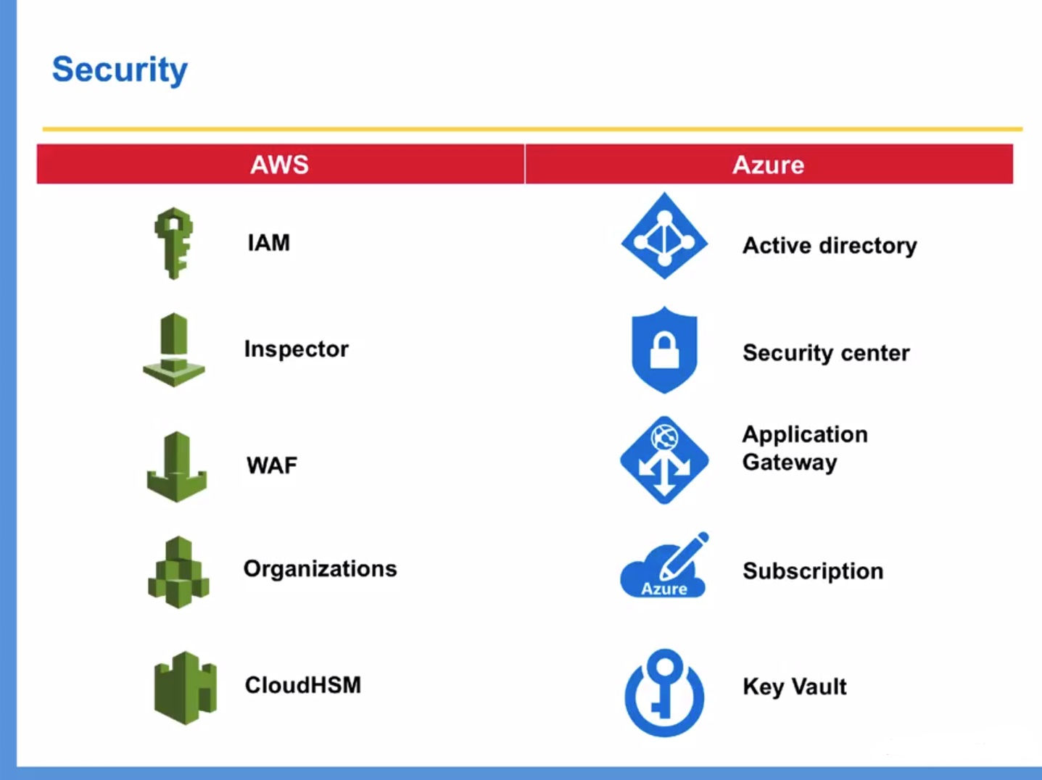

Slide 6
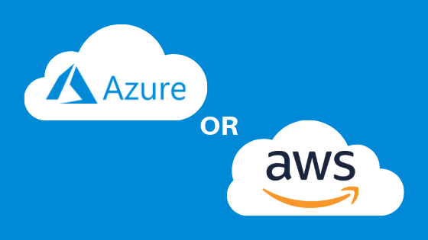

AWS EC2 users can configure their own VMS or pre-configured images whereas Azure users need to choose the virtual hard disk to create a VM which is pre-configured by the third party and need to specify the number of cores and memory required.
AWS offers temporary storage which will be assigned when an instance is started and destroyed when it is terminated and S3 for object storage. Whereas Azure offers temporary storage by block storage through page Blobs for VM’s and Block Blobs for object storage.

Slide 7
•AWS offers Virtual private cloud so that user can create isolated networks within the cloud Whereas Azure offers Virtual network through which we can create isolated networks, subnets, route tables, private IP address range as same as in AWS.
Azure is open to Hybrid cloud systems whereas AWS is less open to private or third-party cloud providers.
•AWS follows pay as you go and they charge per hour whereas Azure also follows pay as you go model and they charge per minute which provides more exact pricing model than AWS.
•AWS has more features and configurations and it offers a lot of flexibility, power, and customization with support for many third party tools integration. Whereas Azure will be easy to use if we are familiar with windows as it is a windows platform and it’s easy to integrate on-premises windows servers with cloud instances to create a hybrid environment

Slide 8

THANK YOU

